Slide 1
Analyzing & Forecasting
Global CO₂ Emissions
Haley Mitchell
Manuella Kwawu
Samantha Silva
Amy Zhou
Zixu Li

Slide 2
Table of contents
01
02
03
04
Overview
EDA
A brief explanation to what we explored
What we explored before we dived into our research questions
Models
Findings & Limitations
What models did we use to investigate at our data
What were our findings

Slide 3
01
Overview
What are we researching and why is it important?

Slide 4
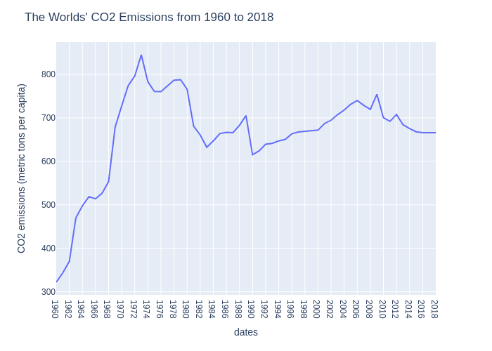
Motivation
Elevated Levels of CO₂ pose a high risk to earth and humanity
CO₂ is a major greenhouse gas that traps heat within the atmosphere which leads to higher temperature
This increase in CO₂ not only poses a threat to humanity, but also varying species below and above water
Notes:
Explain a little bit about the graph and that even though there seems to be a bit of a decline, the co2 emissions per capita is still extremely high. We wanted to create a predictive model that would show us the co2 emissions in the next ten years

Slide 5
Our Research Goals
Question 1
Question 2
Question 3
What does data tell us about the current state of the world’s CO₂ emissions
What are the countries with the highest CO₂ emissions and how will their CO₂ emissions change over the next 5/10 years?
Which continent has the highest rate of CO₂ emission?

Slide 6
The Data
Shows Countries and their recorded CO₂ Emissions
in metric tons per capita
from 1960 to 2018

Slide 7
Data Cleaning
Dropped observations with more than 25% of their yearly records missing
Imputed remaining missing values using the 5 Nearest Neighbors
Dropped records non-countries / groups of countries
Notes:
We tried to use the mean but it yield really high values that did not really flow well into the rest of the records

Slide 8
02
EDA

Slide 9
Our interactive dashboard

Slide 10
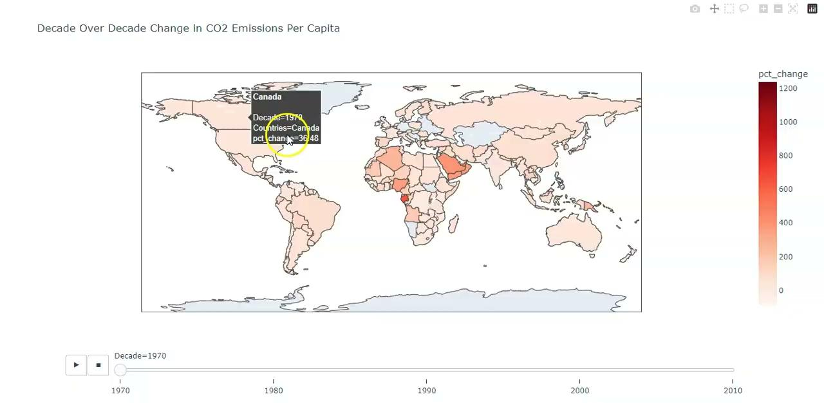
Evolution of Global CO2 Emissions

Slide 11
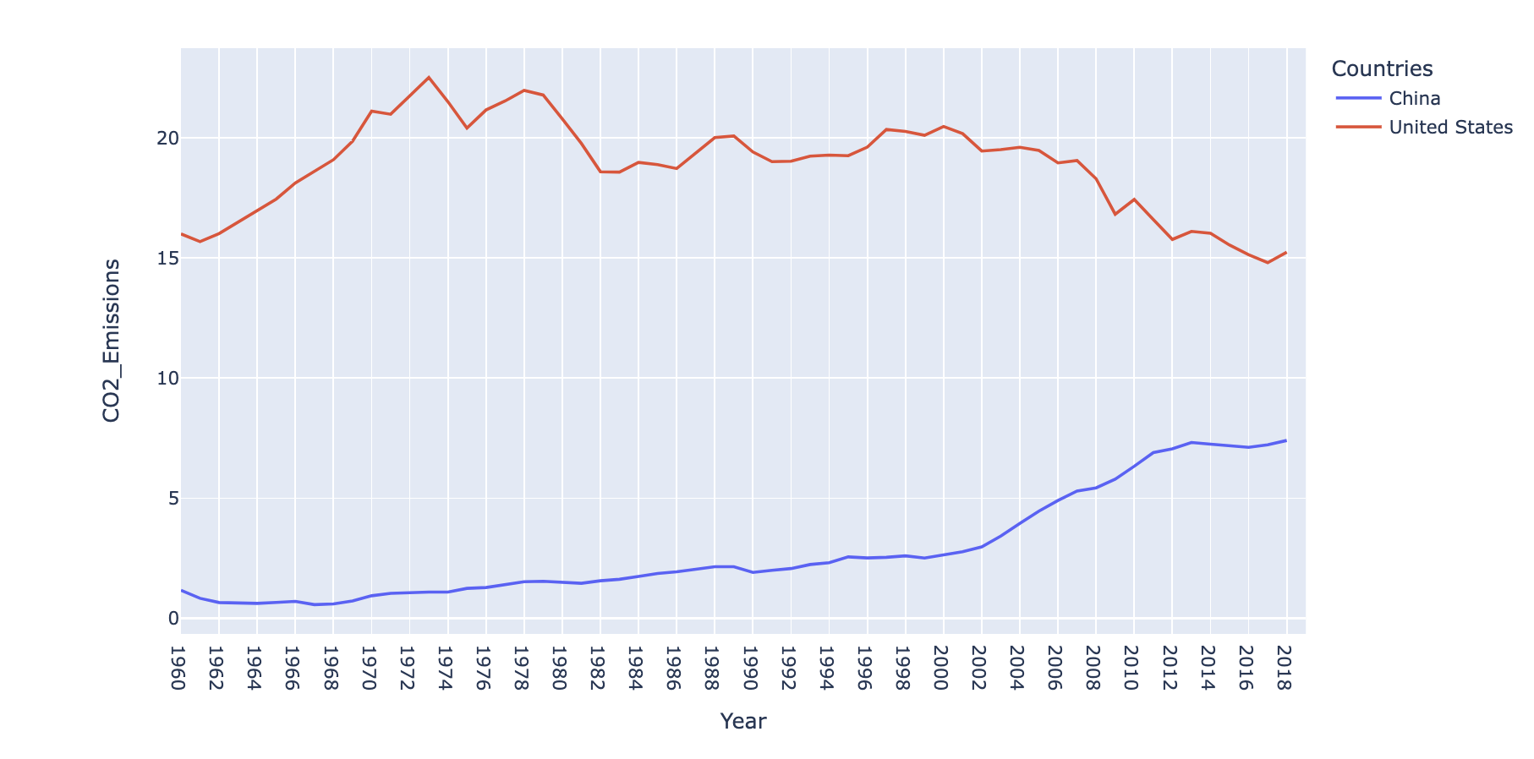
The World’s Top Emitters

Slide 12
03
Model Building Process

Slide 13
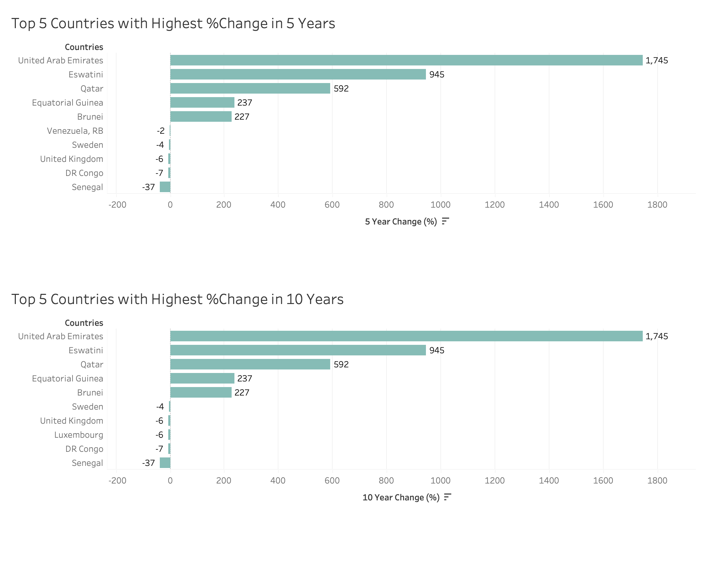
Growth Rate Model
First ‘model’ was using only EDA
Determined the rate of change in CO2 emissions in 5 and 10 years
Very inaccurate model that did not match up to the actual 2019 and 2020 data nor did it seem to have the same accuracy as later models
Notes:
Calculated a Growth Rate using percent change and mean of each Countries data
Used Growth Rate to calculate predicted CO2 Emission values

Slide 14
Early Predictive Models
ARIMA
A statistical analysis model for time series data
Model implicitly assumes that the future will resemble the past.
Not good enough
Linear Regression
Statistical model for estimating linear relationships
Yielded large negative score in one fold indicates inconsistency across different folds
Notes:
Autoregressive Integrated Moving Average (ARIMA)
A statistical analysis model for time series data to either better understand the data set or to predict future trends.
Autoregressive models implicitly assume that the future will resemble the past. Linear Regression
Statistical model for estimating linear relationship between an independent variable and a dependent variable.
Used 5 folds for the linear regression model

Slide 15
Where we went from there…
Random Forest Regressor
Convolution Neural Network
Ensemble Learning
A supervised learning algorithm and bagging technique, used for classification and regression
Deep learning method, use for image data and sequential data analysis.
Adaptively learn spatial hierarchies of features of input data.
Combines the predictions from multiple models. Actually, Random Forest is already an ensemble learning method.

Slide 16
General Procedure
Data Preparation
Model Training
Predictions & fine tuning

Slide 17
Random Forest Regression Model
Performance:
Average RMSE: 1.26
Average cross-validation score: 1.94
Fold 4 have significantly larger error: variability by data split
RandomForestRegressor in sklearn
Feature(X), targets(y)
TimeSeriesSplit
5-fold cross validation

Slide 18
Convolutional Neural Network
Performance:
Average RMSE: 0.93
Average cross-validation score: 0.91
Relatively similar RMSE for each fold => less variation
PyTorch
Four fully-connected layers
Three Dropout layer: regularization
ReLu: activation
5-fold cross validation
Adam: optimizer

Slide 19
Ensemble Learning
Performance:
Average RMSE: 1.14
Average cross-validation score: 1.01
Maintained less variation along with less RMSE
Combined prediction from RF and CNN
Standardize the prediction from both model
Use the output above as input for the metamodel
GradientBoostingRegressor

Slide 20
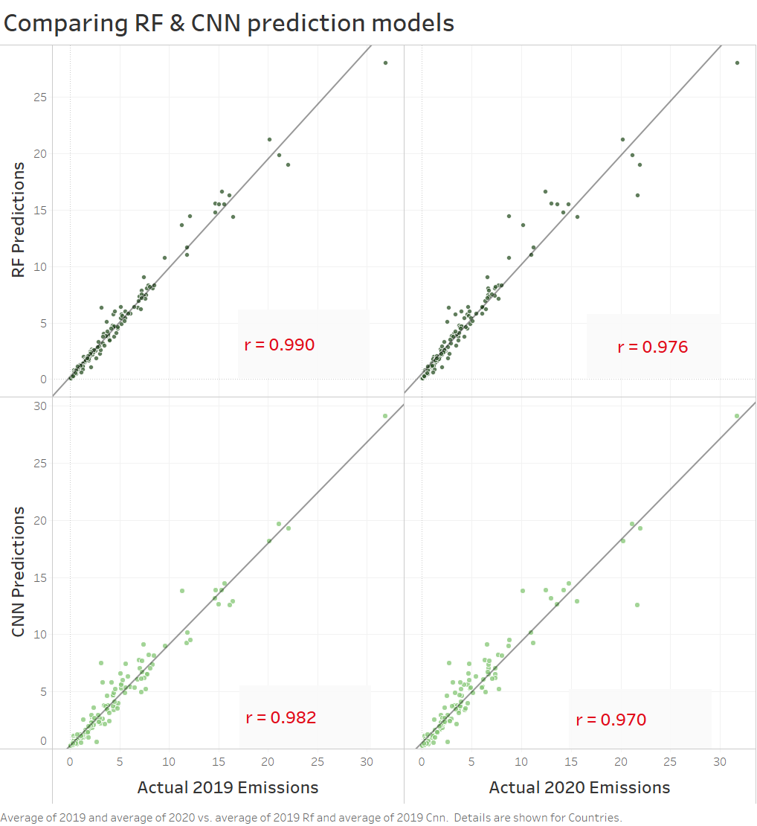
Our Chosen Model
We chose the Random Forest Model as the best model for our data
It had a low average RMSE value of 1.26
When we applied our model to data we found on 2019 and 2020, the correlation coefficient was 0.99 and 0.97 respectively

Slide 21
04
Findings

Slide 22
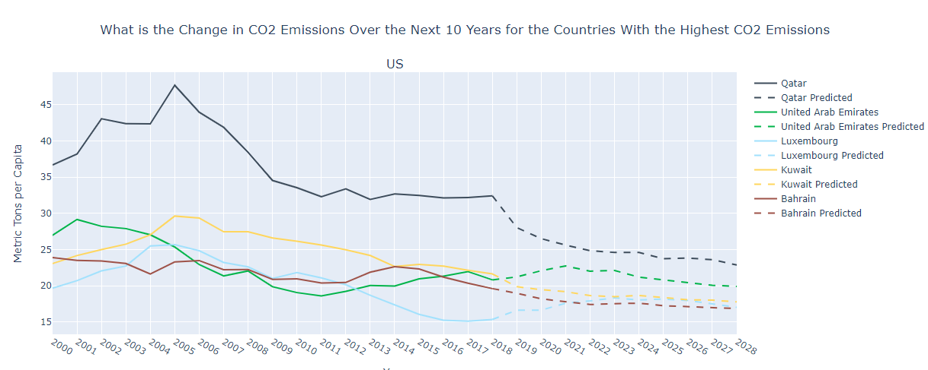
Question: What are the countries with the highest CO₂ emissions and how will their CO₂ emissions change over the next 5/10 years?

Slide 23
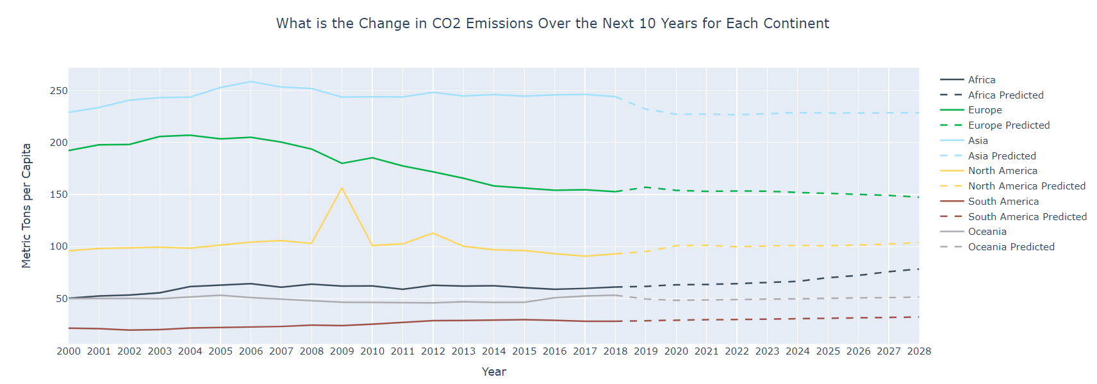
Question: Which continent has the highest CO₂ emission and how do they change over the next 5-10 years?
Lin

Slide 24
Limitations & Future Work
Limitations:
Our model only had one predictor
We removed any data that bundled more than one country
Future Work
Incorporate more variables in the model, such as population or energy consumption

Slide 25
Any Questions?
Source: Slidesgo

Slide 26
Resources
https://machinelearningmastery.com/tour-of-ensemble-learning-algorithms/
https://builtin.com/data-science/random-forest-python
https://www.ibm.com/topics/convolutional-neural-networks [remove later]

